Slide 1
DLA OVERVIEW
Briefer, Position​
Month DD, YYYY
UDPATED AS OF 07/17/25

Slide 2
Agenda
Video: DLA is...The Nation's Logistics Combat Support Agency
DLA Mission, Vision and Strategic Plan
DLA: Warfighter Always – Global Support
Quick Facts
DLA Relationships
Who’s Who in DLA
Major Subordinate Commands
Regional Commands
Support Organizations
J-Codes
DLA as a Whole-of-Government Partner

Slide 3
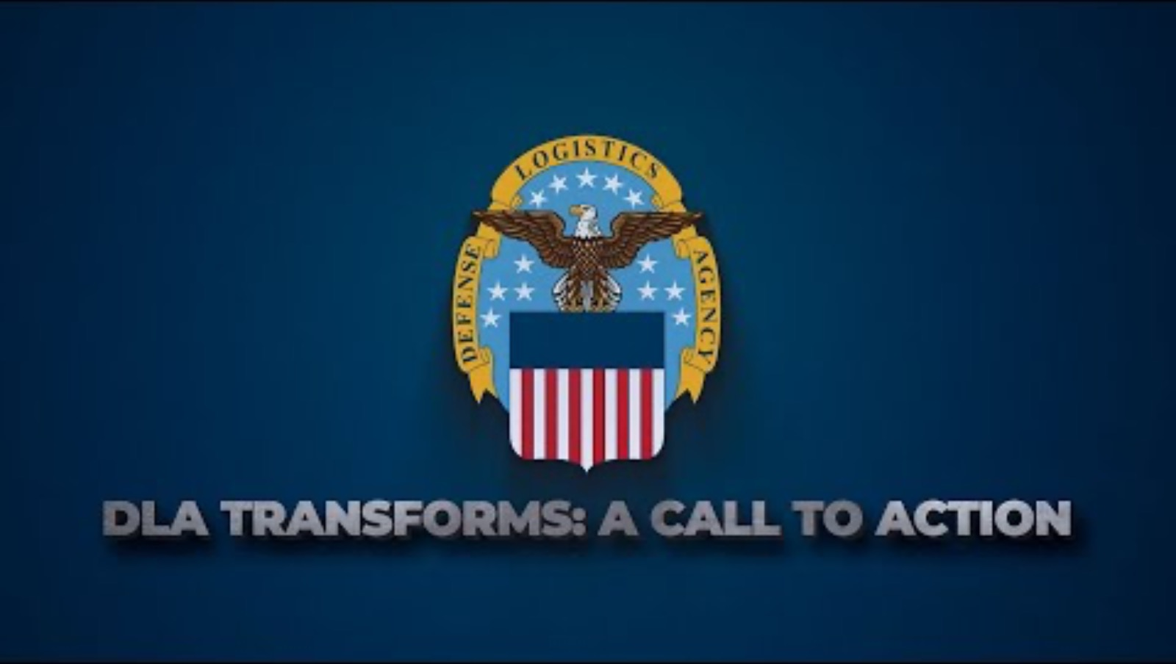
The Nation’s Logistics Combat Support Agency

Slide 4
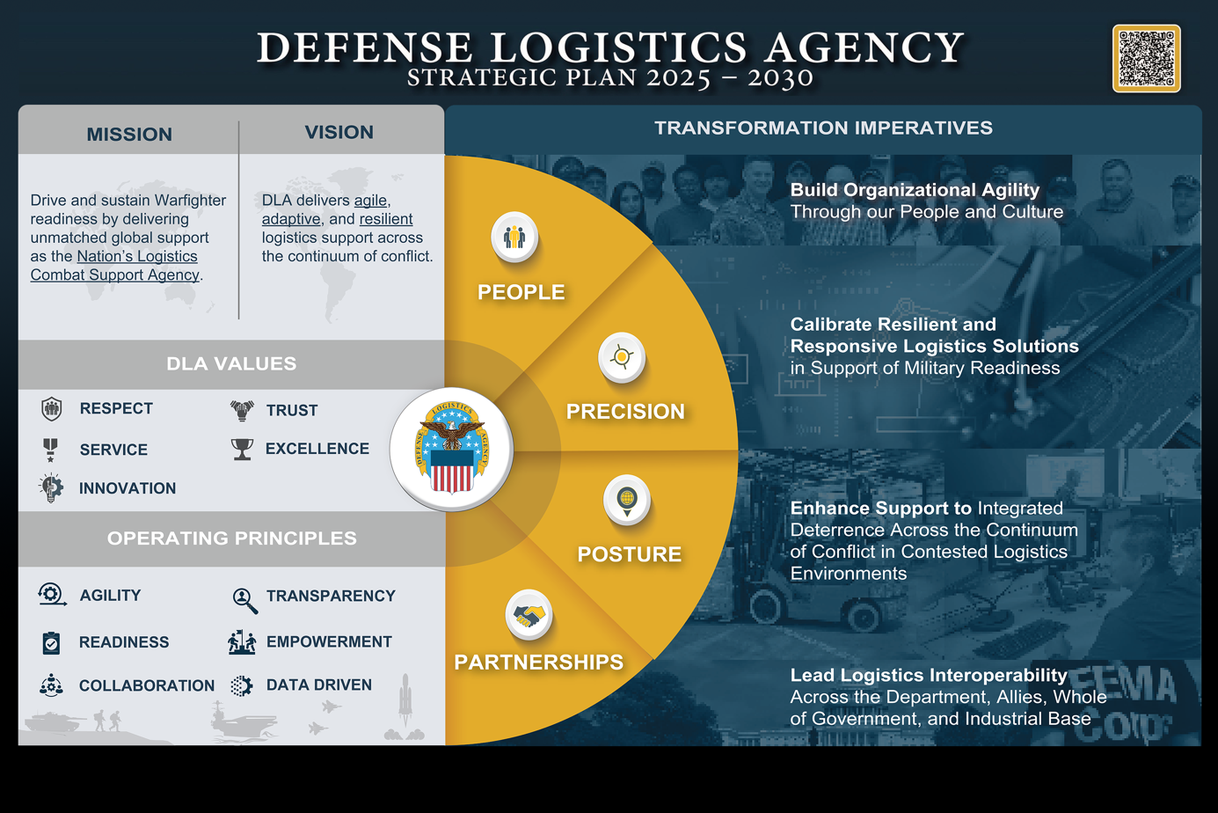
DLA TRANSFORMS
– A Call to Action –
Notes:
The Defense Logistics Agency is our Nation’s Logistics Combat Support Agency, responsible for delivering agile, adaptive, and resilient logistics support across the continuum of conflict. To succeed in an environment where our efforts are contested by adversaries in all domains at all levels of war, we must think, act, and operate in new ways. It is only through meaningful change that we can deliver exceptional global logistics support and win in today’s rapidly changing and Contested Logistics environment.
The DLA Strategic Plan 2025 — 2030 “DLA Transforms: A Call to Action,” was informed by a deliberate Agency assessment and feedback from DLA’s past and present leaders, Military Services, Combatant Commands, our Allies and partners, and industry associates. The plan identifies four transformative imperatives shown here, and provides DLA with its focus: people, precision, posture, and partnerships. These imperatives are grounded in our mission, vision, enduring DLA values, and operating principles. The Strategic Plan is intended to signal the urgent need to change and to provide clarity on the way ahead.
The strategy begins with our mission statement: to drive and sustain Warfighter readiness by delivering unmatched global support as the Nation’s Logistics Combat Support Agency.
Our vision is what we aspire to be. DLA delivers agile, adaptive, and resilient logistics support across the continuum of conflict.
Our values of respect, service, innovation, trust and excellence are our enduring core beliefs.
Our operating principles define DLA’s signature behaviors, and include agility, transparency, readiness, empowerment, collaboration, and being data driven.
The plan identifies four transformative imperatives that will provide DLA with our focus:
• People: Build Organizational Agility Through our People and Culture
• Precision: Calibrate Resilient and Responsive Logistics Solutions in Support of Military Readiness
• Posture: Enhance Support to Integrated Deterrence Across the Continuum of Conflict in Contested Logistics Environments
• Partnerships: Lead Logistics Interoperability across the Department, Allies, Whole of Government, and Industrial Base

Slide 5
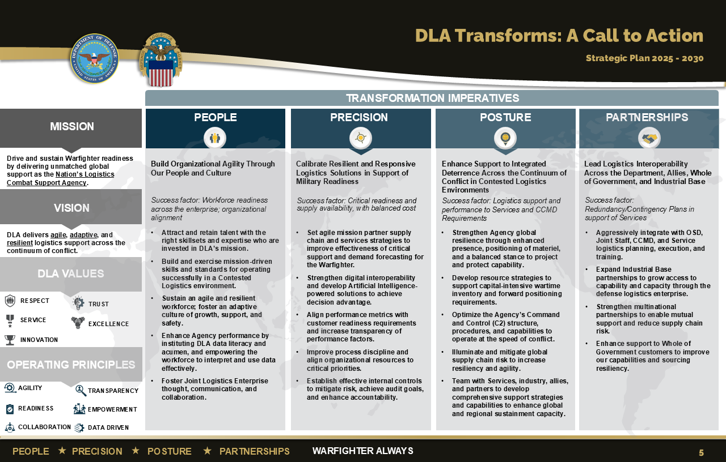
Notes:
The Defense Logistics Agency is our Nation’s Logistics Combat Support Agency, responsible for delivering agile, adaptive, and resilient logistics support across the continuum of conflict. To succeed in an environment where our efforts are contested by adversaries in all domains at all levels of war, we must think, act, and operate in new ways. It is only through meaningful change that we can deliver exceptional global logistics support and win in today’s rapidly changing and Contested Logistics environment.
The DLA Strategic Plan 2025 — 2030 “DLA Transforms: A Call to Action,” was informed by a deliberate Agency assessment and feedback from DLA’s past and present leaders, Military Services, Combatant Commands, our Allies and partners, and industry associates. The plan identifies four transformative imperatives shown here, and provides DLA with its focus: people, precision, posture, and partnerships. These imperatives are grounded in our mission, vision, enduring DLA values, and operating principles. The Strategic Plan is intended to signal the urgent need to change and to provide clarity on the way ahead.
The strategy begins with our mission statement: to drive and sustain Warfighter readiness by delivering unmatched global support as the Nation’s Logistics Combat Support Agency.
Our vision is what we aspire to be. DLA delivers agile, adaptive, and resilient logistics support across the continuum of conflict.
Our values of respect, service, innovation, trust and excellence are our enduring core beliefs.
Our operating principles define DLA’s signature behaviors, and include agility, transparency, readiness, empowerment, collaboration, and being data driven.
The plan identifies four transformative imperatives that will provide DLA with our focus:
• People: Build Organizational Agility Through our People and Culture
• Precision: Calibrate Resilient and Responsive Logistics Solutions in Support of Military Readiness
• Posture: Enhance Support to Integrated Deterrence Across the Continuum of Conflict in Contested Logistics Environments
• Partnerships: Lead Logistics Interoperability across the Department, Allies, Whole of Government, and Industrial Base

Slide 6
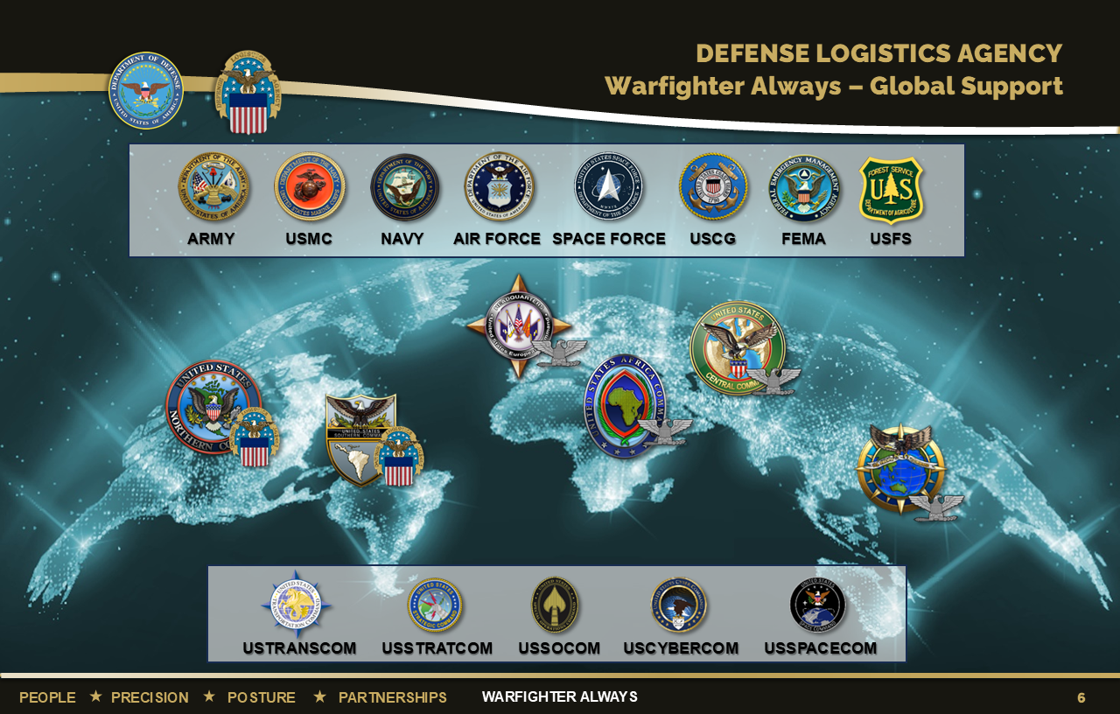
Notes:
As the Nation’s logistics combat support agency, the Defense Logistics Agency manages the end-to-end global defense supply chain – from raw materials to end user disposition – for the five military services, 11 combatant commands, other federal, state and local agencies and partner and allied nations.
DLA sources and provides nearly all the consumable items America’s military forces need to operate, from food, fuel and energy to uniforms, medical supplies and construction material. DLA also supplies the majority of the military’s spare parts, manages the reutilization and disposition of military equipment, provides catalogs and other logistics information products and is DOD’s primary provider of printing services, office print devices and electronic conversion services.
Headquartered at Fort Belvoir, Virginia, DLA is a global enterprise – wherever the nation has a significant military presence, DLA is there to support.
DLA’s major responsibilities are to (1) buy or contract, (2) warehouse when needed, and (3) distribute about 5 million distinct consumable, expendable and reparable items.
DLA acquires items from manufacturers and suppliers that it then provides to DOD and other federal and regional customers, often with supplementary services such as warehousing, packaging and transportation.
DLA also contracts for items that are provided directly by the manufacturer to DLA customers.
As of June 2022

Slide 7
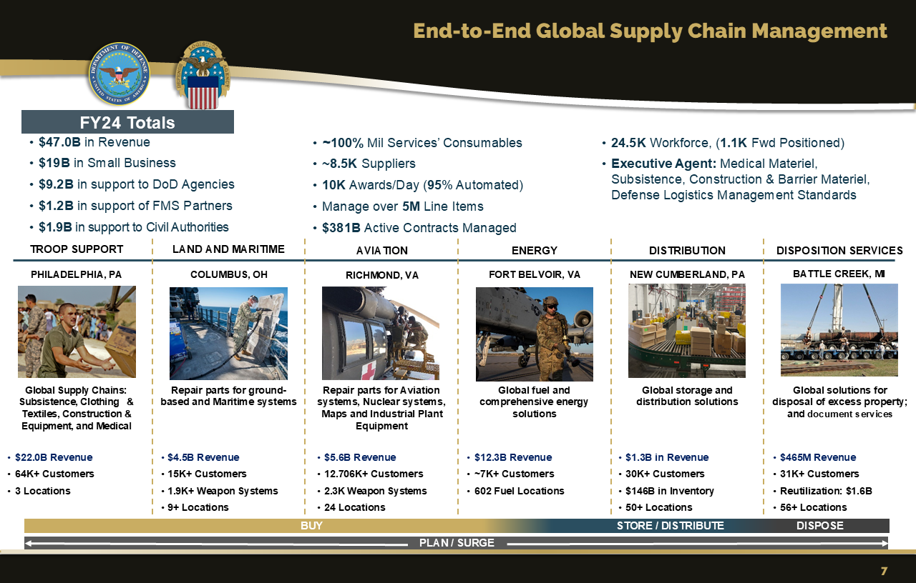
Notes:
DLA Quick Facts:
DLA employs about 25,000 personnel – military and civilian with over 1,100 forward deployed at any one time.
The Agency is comprised of six major subordinate commands – DLA Troop Support, DLA Aviation, DLA Land and Maritime, DLA Energy, DLA Distribution and DLA Disposition Services.
DLA manages $381B in active contracts with approximately 10K awards each day (95% automated) to ~8,500 suppliers
DLA provided more than $47.1 billion in goods and services for FY2024, with ~$19B going to Small Business, ~$9.2B to Small Business, ~$1.2B to Foreign Nation Partners through FMS, and ~$1.9B to Civil Authorities
DLA manages the reutilization and disposition of military equipment and operates a global network of distribution centers

Slide 8
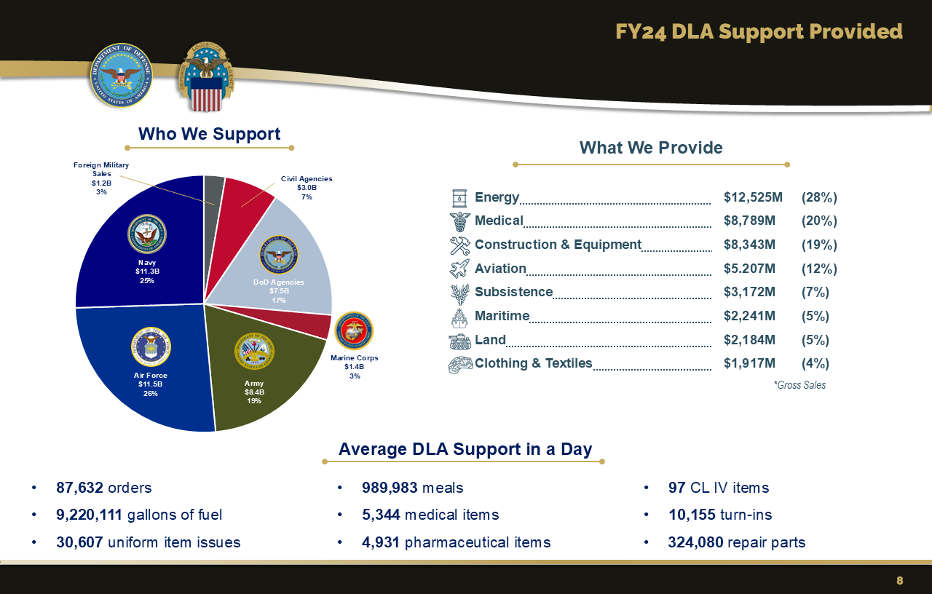
Notes:
DLA manages multiple supply chains – Subsistence, Clothing and Textiles, Construction and Equipment, Medical, Aviation Systems, Land Systems, Maritime Systems and Fuel and Energy
This chart shows who we support, what we provide, and the average support DLA provides to its customers in a day.

Slide 9
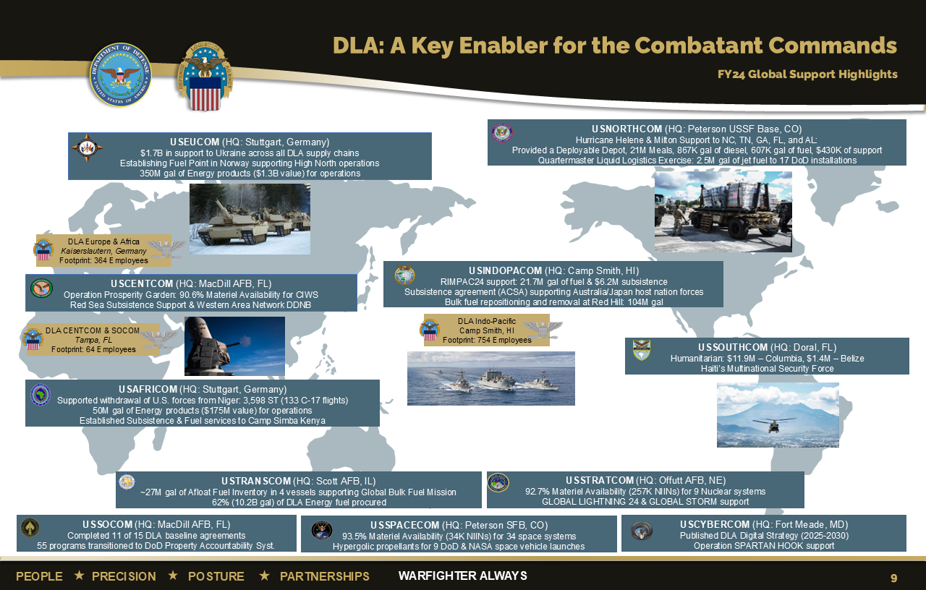
Notes:
As a Combat Support Agency, DLA is an integral element of the Joint Logistics Enterprise, providing effective, efficient, and risk-mitigated worldwide logistics support to globally integrated DoD operations under conditions of peace and war.
In FY24, DLA provided robust 24/7 global support to CCMDs, with a primary focus on agile and resilient sustainment, increasingly integrated planning, and enhanced exercise participation for the CCMDs.
As a Combat Support Agency, DLA is an integral element of the Joint Logistics Enterprise. By design, DLA is embedded with Combatant Commands to support globally integrated operations during peace and war.

Slide 10
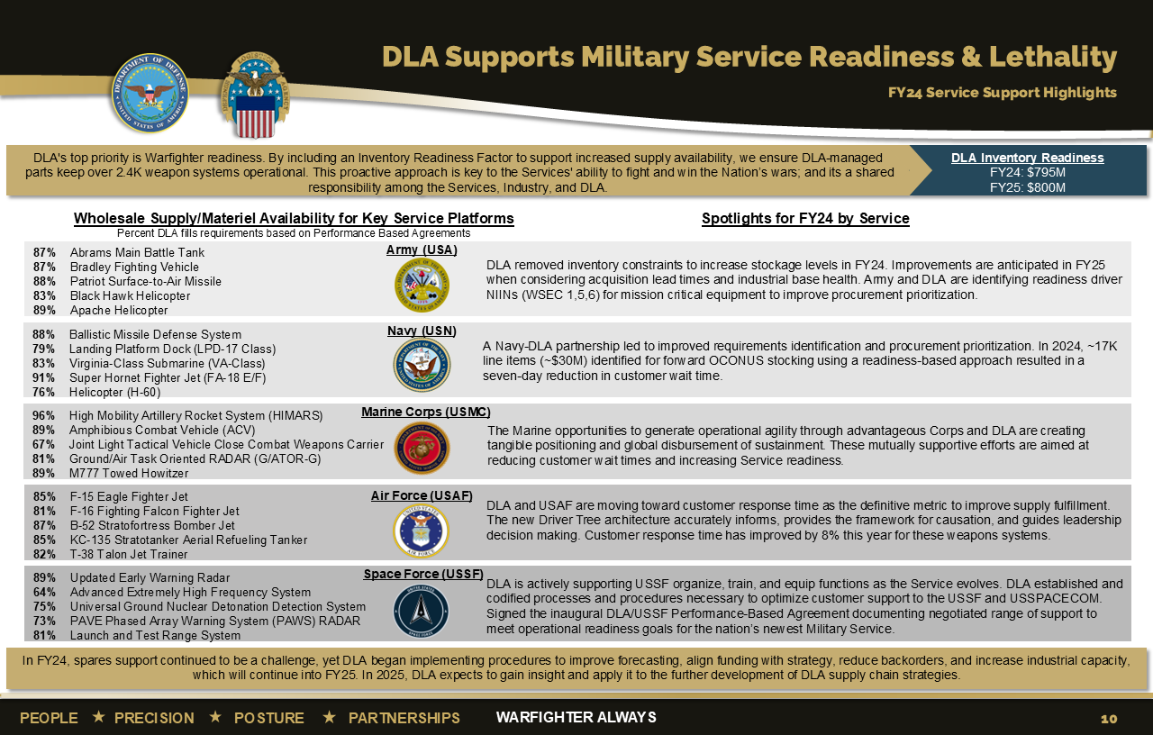
Notes:
Every critical facet of DLA’s end-to-end supply chain contributes to the readiness of the Services and ultimately, the preparedness of the Department of Defense to carry out the National Defense Strategy.

Slide 11
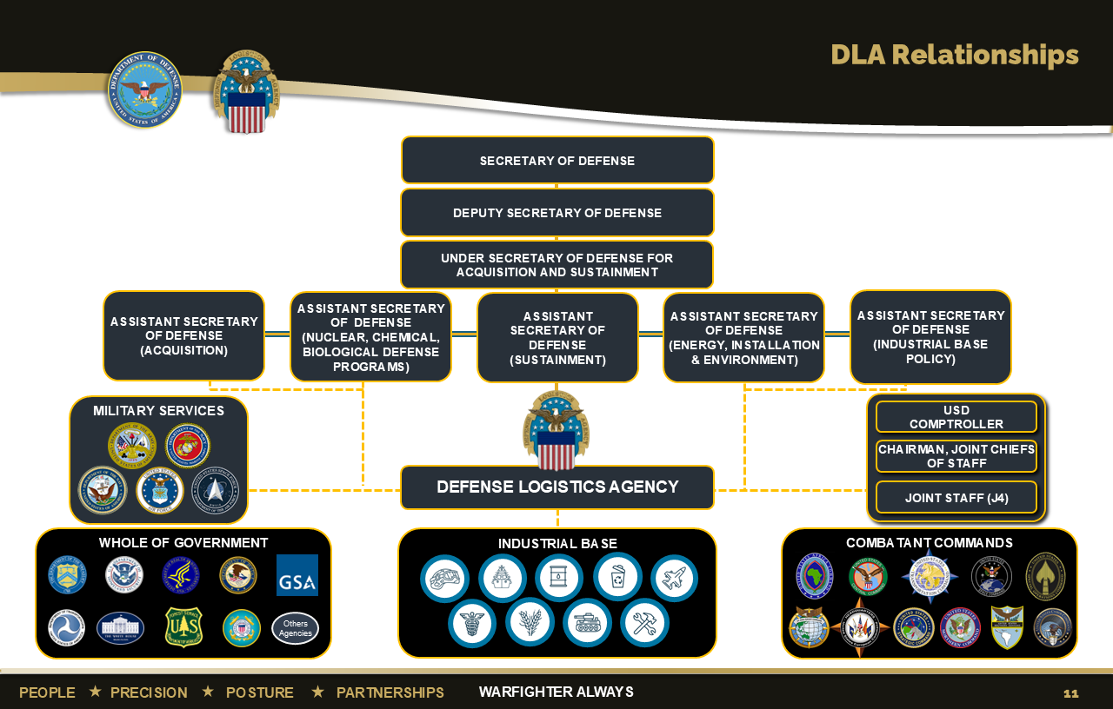
Notes:
DLA Relationships
The DLA Director reports to the Under Secretary of Defense for Acquisition and Sustainment, through the Assistant Secretary of Defense for Sustainment
We coordinate very closely across the Acquisition and Sustainment portfolio. Examples:
(J7) ASD (Acquisition); Defense Contract Management Agency; Director Defense Pricing and Contracting
(J3/J7) ASD (Sustainment); Director, Defense Microelectronics Activity; DASD Logistics; DASD Product Support; DASD Materiel Readiness
(J3/DLA Energy) ASD (Energy, Installations and Environment)
(DLA-DI) ASD (Nuclear, Chemical, Biological Defense Programs); includes Defense Threat Reduction Agency
(J7/Stockpile) ASD (Industrial Base Policy)
As defined by our charter, DoDD 5105.22 (2017), signed by the DSD, DLA has strong ties across the DoD to include the Joint Staff, the Military Services, Combatant Commands, as well as the Whole of Government. We are undergoing a rewrite of our charter.
Directly coordinates with Department of Health and Human Services (HHS), Department of Homeland Security (DHS), the U.S. Forest Service, the General Services Administration (GSA), and others
We are proud of our ability to simultaneously support the Military Services and the Whole of Government while ensuring we never lose sight of our “Warfighter Always” primary mission

Slide 12





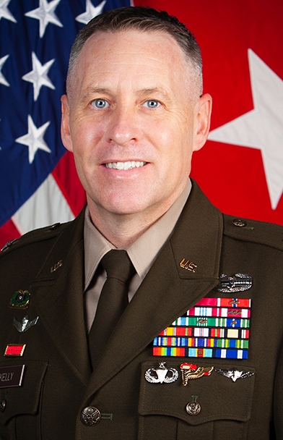



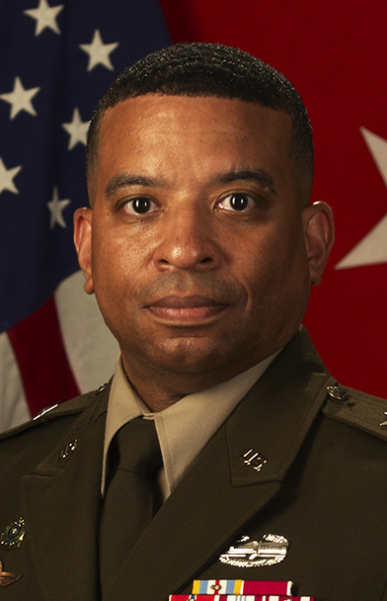

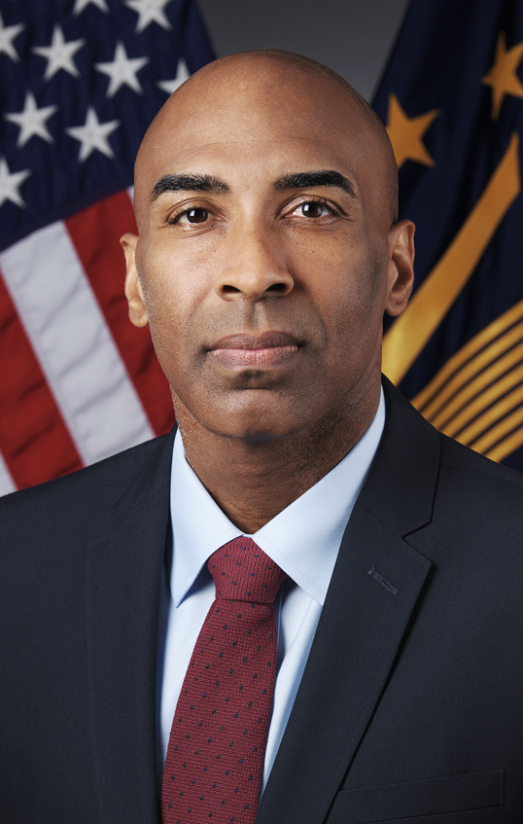


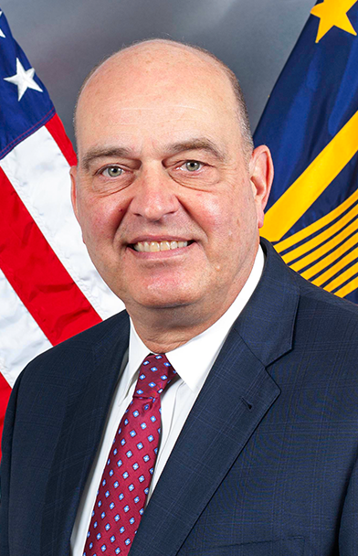




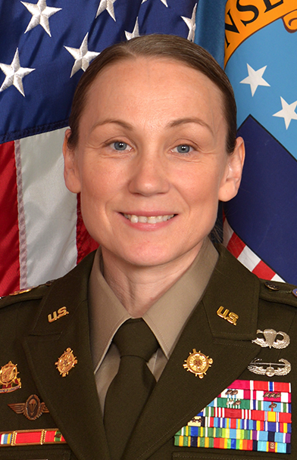



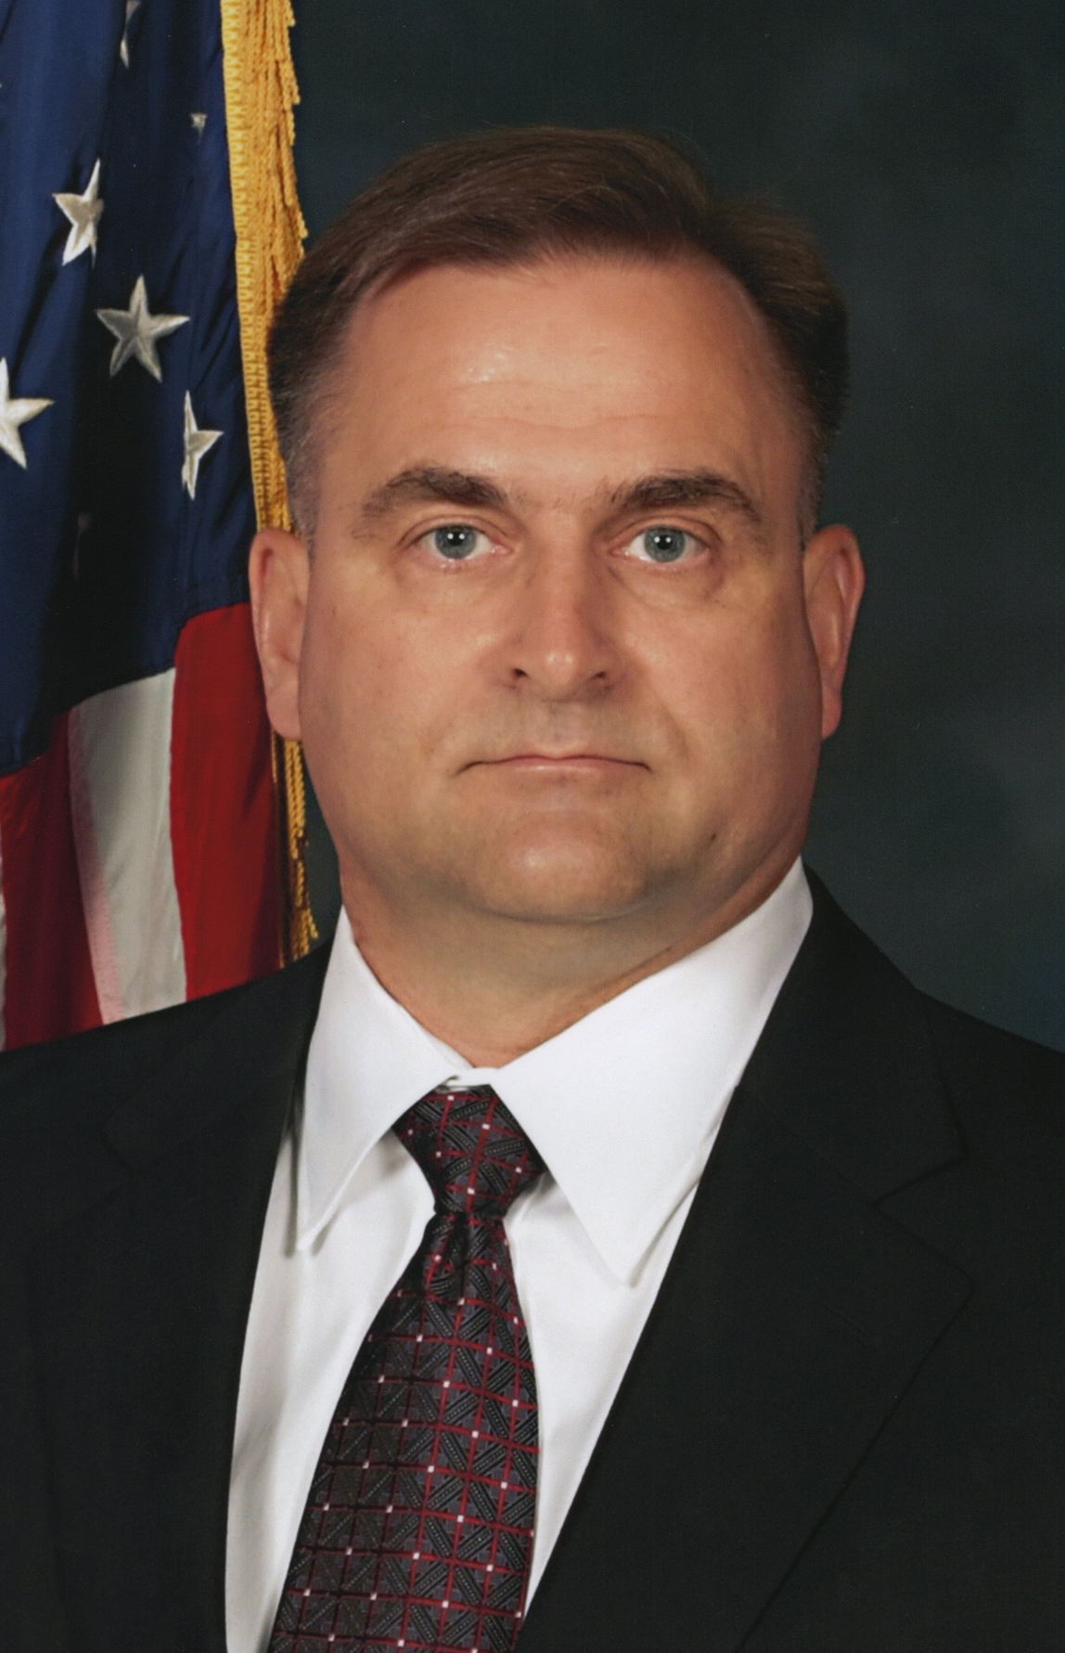






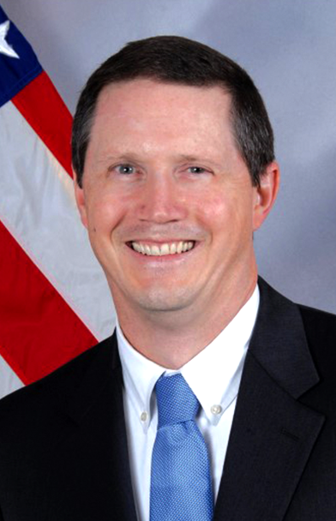
WHO’S
LTG MARK T. SIMERLY, USA DIRECTOR
BRAD BUNN
VICE
DIRECTOR
CSM PETRA M.
CASAREZ, USA
SENIOR ENLISTED LEADER
KARYN
RUNSTROM
CHIEF OF STAFF
WHO
IN DLA
BG SEAN P.
KELLY, USA
COMMANDER
DLA TROOP SUPPORT
BRIG GEN PATRICK R.
LAUNEY, USAF
COMMANDER
DLA WEAPONS SUPPORT (RICHMOND)
RDML JULIE
TREANOR
COMMANDER
DLA WEAPONS SUPPORT (COLUMBUS)
RDML GEORGE E. BRESNIHAN, USN
COMMANDER
DLA ENERGY
BG KEVIN L.
COTMAN, USA
COMMANDER
DLA DISTRIBUTION
MICHAEL O.
CANNON
DIRECTOR
DLA DISPOSITION SERVICES
CHARLES
BARBER
DIRECTOR
HUMAN RESOURCES
(J1)
MAJ GEN DAVID
SANFORD, USAF
DIRECTOR
LOGISTICS
OPERATIONS
(J3)
Adarryl
Roberts
DIRECTOR
INFORMATION
OPERATIONS
(J6)
MATTHEW R.
BEEBE
DIRECTOR
ACQUISITION
(J7)
SUSAN J.
GOODYEAR
DIRECTOR
FINANCE
(J8)
MG TRIPP
BOWLES, USA
DIRECTOR
JOINT RESERVE FORCE
(J9)
CAPT PATRICK W. BROWN, USN
COMMANDER
DLA
INDO-PACIFIC
COL EDWARD RUNYAN, USA
COMMANDER
DLA CENTCOM & SOCOM
COL TRACY
YATES, USA
COMMANDER
DLA EUROPE
& AFRICA
JOSE A.
CORA
DIRECTOR GENERAL COUNSEL
(DG)
DANIELE J.
KURZE
EXECUTIVE
DIRECTOR
SMALL BUSINESS
PROGRAMS
(DB)
DAVID J.
OPATZ
DIRECTOR
OFFICE OF THE INSPECTOR GENERAL
(OIG)
TOD D. MELLMAN
DIRECTOR
SAFETY AND OCCUPATIONAL HEALTH
(DCS)
IAN M.
KELLY
DIRECTOR
INSTALLATION MANAGEMENT (DM)
CH (COL) THOMAS A. BROOKS, USA
COMMAND
CHAPLAIN
(DH)
ADRAIN
CLAY
DIRECTOR
INTELLIGENCE
(DI)
MICHAEL L.
JOHNSON
DIRECTOR
LEGISLATIVE AFFAIRS
(DL)
JOSEPH
YOSWA
DIRECTOR
PUBLIC AFFAIRS
(DP)
JANICE SAMUEL
DIRECTOR
EQUAL EMPLOYMENT OPPORTUNITY
(DO)
BRUCE
BLANK
DIRECTOR
TRANSFORMATION
(DT)
12
Notes:
Director—LTG Mark T. Simerly, USA
Vice Director—Mr. Brad Bunn
Senior Enlisted Leader—CSM Petra M. Casarez, USA
Chief of Staff—Ms Karyn Runstrom
COMMANDERS, MAJOR SUBORDINATE COMMANDS
Commander, DLA Troop Support—BG Sean P. Kelly, USA
Commander, DLA Weapons Support (Richmond)—Birg. Gen. Patrick R. Launey, USAF
Commander, DLA Weapons Support (Columbus)—RDML Julie Treanor, USN
Commander, DLA Energy—RDML George E. Bresnihan, USN
Commander, DLA Distribution—BG Kevin L. Cotman, USA
Director, DLA Disposition Services—Mr. Michael Cannon
J CODES
Director, Human Resources—Dr. Charles Barber
Director, Logistics Operations—MAJ GEN David Sanford, USAF
Director, Information Operations—Mr. Adarryl Roberts
Director, Acquisition—Mr. Matthew Beebe
Director, Finance—Ms. Susan J. Goodyear
Director, Joint Reserve Force—MG Tripp Bowles
COMMANDERS, REGIONAL COMMANDS
Commander, DLA Indo-Pacific—CAPT Patrick W. Brown, USN
Commander, DLA CENTCOM & SOCOM—COL Edward Runyan, USA
Commander, DLA Europe & Africa—COL Tracy Yates, USA
STAFF
Director, General Counsel—Mr. Jose A. Cora
Executive Director, Small Business Programs—Daniele J. Kurze
Director, Inspector General—Mr. David J. Opatz
Director, Safety and Occupational Health -- Tod D. Mellman
Director, Installation Management—Mr. Ian M. Kelly
Command Chaplain—Chaplain (COL) Thomas A. Brooks , USA
Director, Intelligence—Mr. Adrain Clay
Director, Legislative Affairs—Mr. Michael L. Johnson.
Director, Public Affairs—Mr. Joseph Yoswa
Director, Equal Employment Opportunity—Ms. Janice Samuel
Director, Transformation—Mr. Bruce Blank
As of September 2025

Slide 13
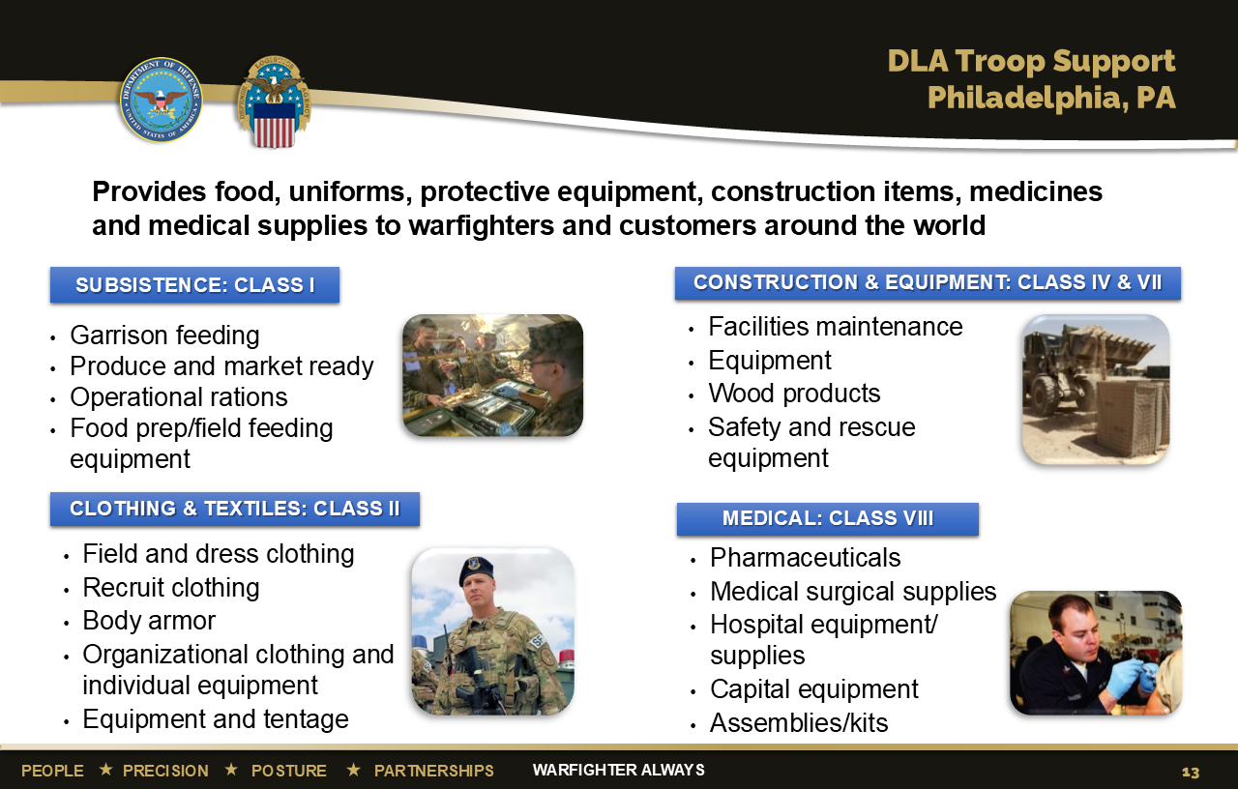
13
Notes:
DLA Troop Support provides U.S. service members with food, clothing, textiles, construction supplies and equipment, medicines, and medical equipment. They also support other federal agencies, and humanitarian and disaster relief efforts around the world.
The Subsistence supply chain provides food support for the military all over the world. This supply chain serves as the key link between the Armed Forces and the U.S. food industry. It also provides support to other federal agencies, the Veterans Administration, Public Health Service hospitals, the USDA's National School Lunch Program, and the District of Columbia School District.
The Clothing and Textiles supply chain provides clothing, textiles, and equipment to U.S. service members, other federal agencies, and partner nations. C&T procures more than 8,000 different items from uniforms, footwear, and undergarments to ecclesiastical items, individual equipment, flags and tents.
The Construction and Equipment supply chain supplies items for force protection, safety and rescue, fire and emergencies, storage, HVAC, plumbing, heavy equipment, metals and lumber, as well as marine life saving and diving equipment, imaging and telecommunication devices, targets for training, and automated data processing equipment and supplies.
The Medical supply chain provides medical products and services needed every day for every crisis around the world. Support includes surgical items, preventive vaccines, field hospital equipment as well as medical supplies for animals.
As of June 2022

Slide 14
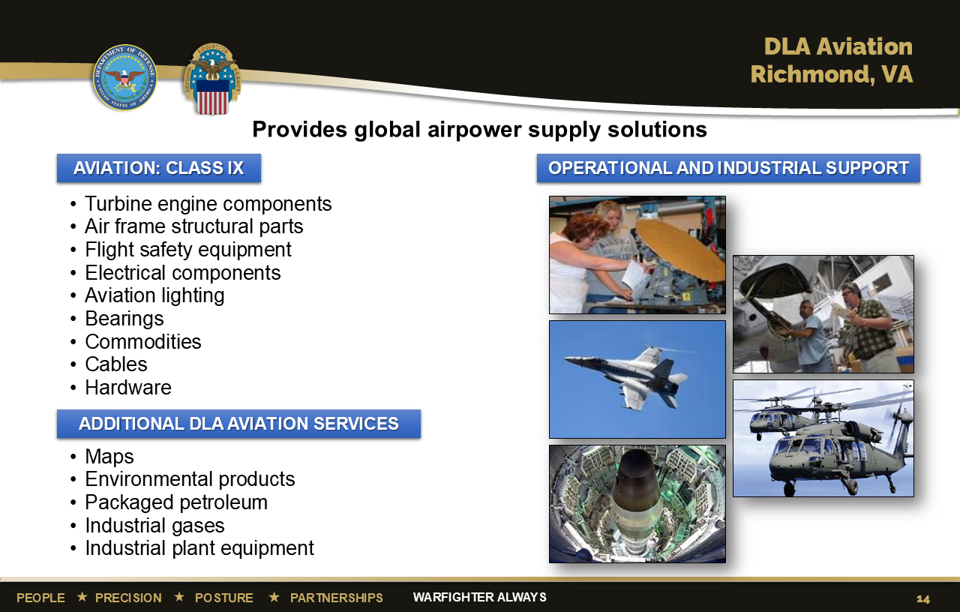
Notes:
DLA Aviation employs more than 4,000 civilian and military personnel in 18 locations across the United States. We provide aviation weapons systems and environmental logistics support to the defense aviation community and other governmental customers. DLA Aviation supports more than 13,500 joint aircraft, 450 intercontinental ballistic missiles, and host of other weapons systems, and is the U.S. military’s integrated material manager for more than 1.7 million national stock number items, industrial retail supply and depot-level reparable acquisitions.
A proven performer, DLA Aviation had $4,943 billion in sales during fiscal year 2021, processed 3.9 million customer orders during the year; and conducted business with more than 3,400 suppliers as part of its support to its 12,287 customers.
DLA Aviation’s primary mission is to support the warfighter by providing Aviation repair parts and components to include engine components, airframe structural parts, flight safety equipment, electrical components, lighting, bearings, cables, and other commodity items.
DLA Aviation is responsible for supply at six major industrial maintenance, repair, and overhaul facilities, and for storage operations at three. DLA Aviation also operates five depot-level reparable procurement organizations.
DLA Aviation delivers unique customer support capabilities through its Industrial Plant Equipment Services and Mapping Customer Operations Divisions. IPES operates the only industrial plant equipment management facility and maintenance depot in the federal government dedicated to procuring, rebuilding, retrofitting, and repairing metalworking machinery for the Department of Defense and other federal agencies. Mapping Customer Operations provide exceptional supply and demand chain support by providing aeronautical, digital, hydrographic, and topographic maps to geospatial intelligence customers.
DLA Aviation plays a pivotal role in supporting our soldiers, Marines, sailors, airmen, and other customers by providing targeted solutions and full-spectrum logistics support.
DLA Aviation also provides some unique services to warfighters and other customers such as FEMA, Department of the Interior, etc.
These unique services include:
The DLA HAZMIN and Green Products team under the Aviation Supply Chain’s Engineering Directorate has the mission to support DOD’s Sustainability Policy by helping DLA’s military customers to “Buy Green.” The team provides technical assistance and logistics guidance to its military service customers with respect to Pollution Prevention Programs, Green Products, and overall sustainability issues.
Examples include: Recycled content products, Less toxic and low VOC products, Energy and water-conserving products, Bio-based products, and alternatives to hazardous items such as lead, mercury and cadmium.
The ODS Reserve is DOD's central manager for the turn-in, storage, reclamation and issuance of mission-critical ODS for all of the military services and the Coast Guard. The Reserve provides the DOD the capability to recover and centrally receive, reclaim, store and issue ODS.
The Hazardous Materials Information Resource System (HMIRS) is the central repository for information on hazardous materials used by DOD. HMIRS is an automated system containing Safety Data Sheets (SDS) information and item-specific value-added data such as transportation, logistics, and disposal procedures and OSHA-compliant hazardous warning label information. HAZMAT HELPLINE provides technical assistance on day-to-day regulated materials issues via a helpline through web, e-mail, or telephone in the areas of Environment, Occupational Safety & Health, Transportation, Packaging, Storage-Handling, Pollution Prevention, and Logistics.
As of July 2022

Slide 15
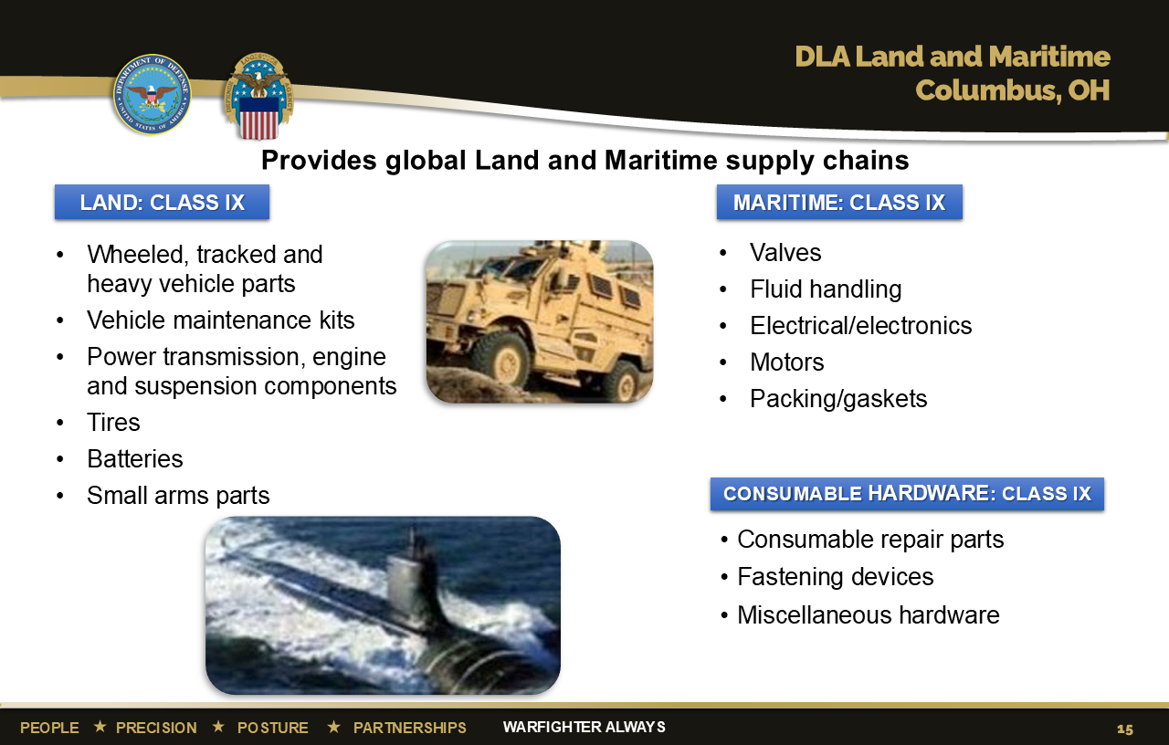
Notes:
Throughout the world, DLA Land and Maritime is known to more than 25,000 military and civilian customers and 10,000 contractors, as one of the largest suppliers of weapons systems spare parts.
DLA Land and Maritime manages 2 million items, awards more than 322,000 contracts annually, supports nearly 1,800 weapons systems, and handles more than 9 million orders annually, with annual sales topping $4 billion.
Land and Maritime was the first inventory control point in DLA to develop a weapons systems approach toward materiel management. Weapons systems management is now standard procedure in DLA, and Land and Maritime is the lead ICP for land, maritime and missile weapons systems.
Today, having transformed from being a wholesaler to an end-to-end supply chain manager, DLA Land and Maritime's state-of-the-art systems connect business processes from the supplier to the customer through the Land and Maritime supply and demand chains.
As of June 2022

Slide 16
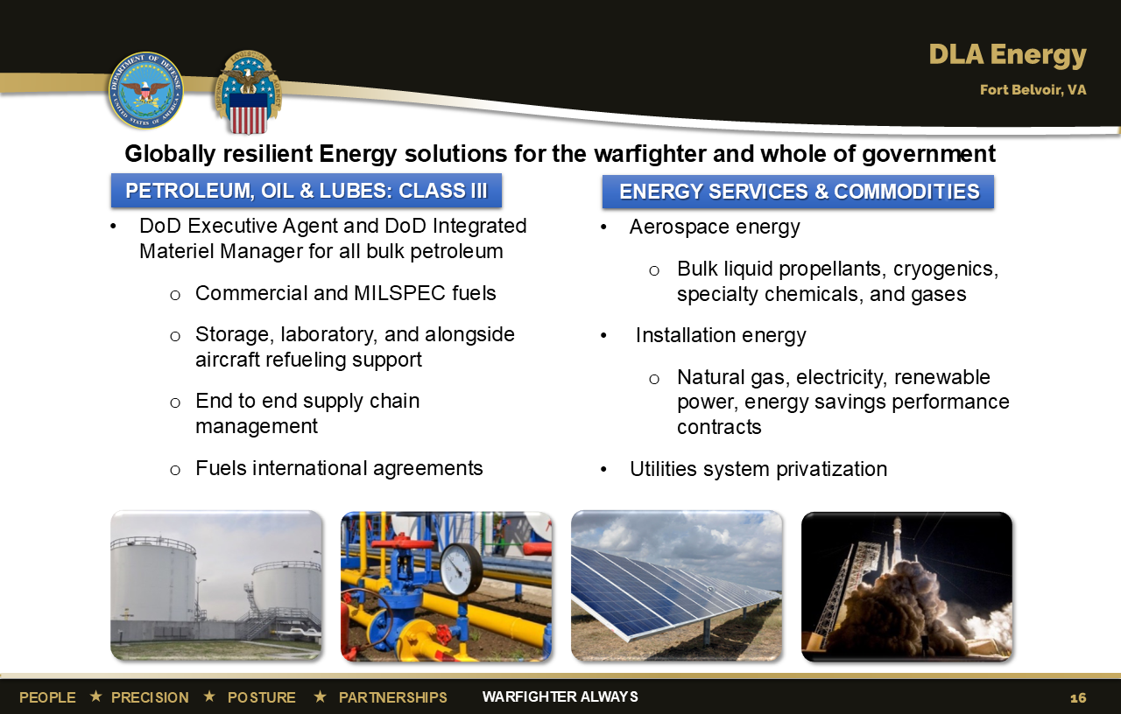
Notes:
DLA Energy provides energy to the military services, the Department of Defense and other federal agencies at more than 4,000 locations worldwide. In fiscal year 2021, DLA Energy recorded approximately $8.8 billion in sales and issued a total of 3.7 billion gallons of fuel. In addition, $740M in Whole-of-Government support, $872.8M sold via Fuel Card Program.
DLA Energy procures petroleum products – jet fuels, aviation and automotive gasoline, heating oil and lubricants.
In addition to providing extensive contracting and technical support for the privatization of installation utility systems, including electric, natural gas, water and wastewater systems, DLA Energy performs the centralized contract administration function for the utility service contracts, which can last up to 50 years.
DLA Energy supports commodities and services including coal, natural gas, electricity, renewable energy, energy savings performance contracts and long term renewable energy project development.
DLA Energy Aerospace Energy manages the worldwide acquisition of missile and rocket fuels, propellants for systems to include satellites and aerostats, as well as aviator’s breathing oxygen and other bulk industrial gases.
As of June 2022

Slide 17
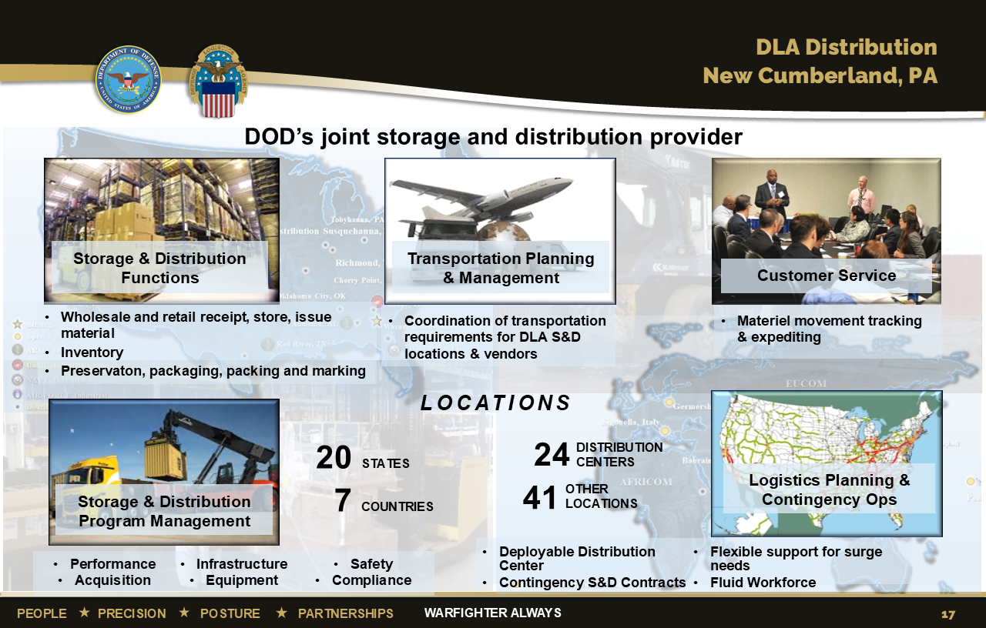
Notes:
DLA Distribution employs almost 10,000 people and has more than 50 locations worldwide. Those locations include distribution centers, an expeditionary team that serves as a mobile distribution center, consolidation and containerization points, theater consolidation and shipping points, materiel processing centers, recruit training centers and meals ready to eat storage sites.
DLA Distribution supply centers manage materiel and offer services including storage, distribution, custom kitting, specialized packaging as well as transportation support and technology development—all aimed at increasing warfighter readiness. The centers and sites have more than 2.5 million item numbers in stock worth more than $138 billion.
In fiscal year 2021, DLA Distribution had more than 17.4 million global transactions.
As of June 2022

Slide 18
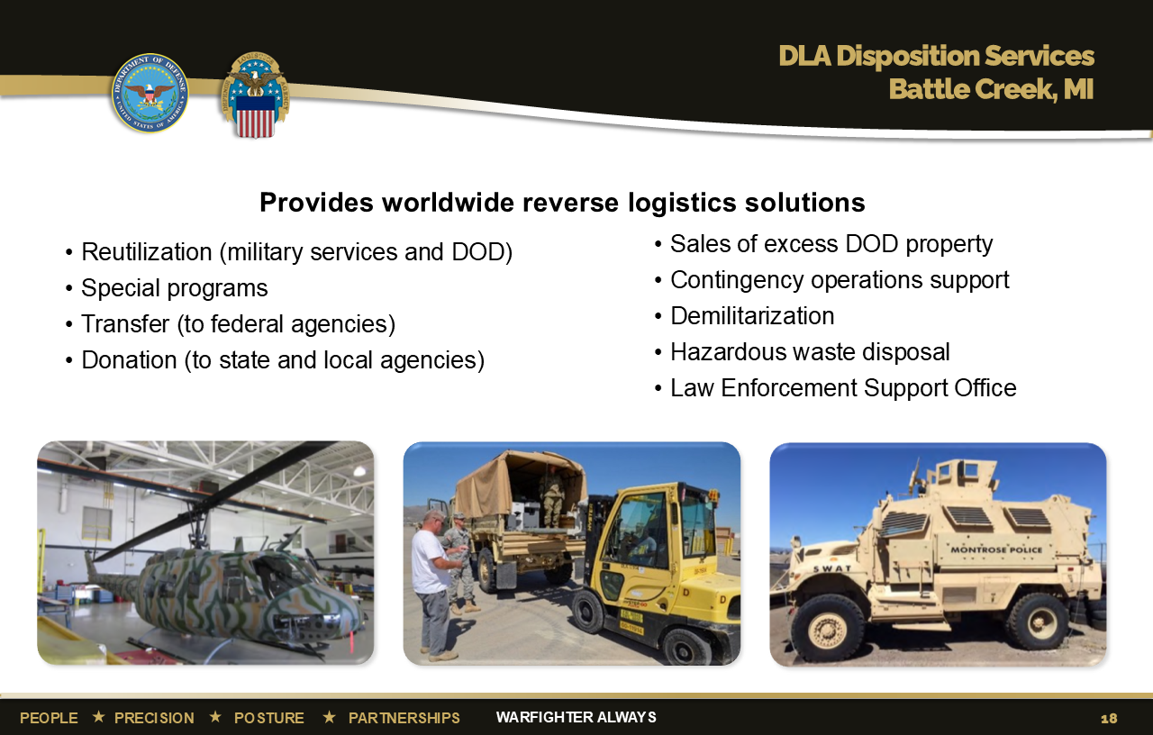
Notes:
DLA Disposition Services plays a large role in the reuse or disposal of materiel no longer required by military forces, both usable items and scrap. DLA Disposition Services sites are on military installations at home and abroad.
The activity accepts excess usable items from military units and facilitates its reuse by other military units, transfers appropriate materiel to other federal agencies or donates it to state and local governments.
Under special programs, schools across the country can acquire excess computers and other IT technology for free. Working with the U.S. Forest Service, Disposition Services provides free vehicles and equipment to firefighters. The congressionally established Law Enforcement Support Office program provides certain types of equipment to law enforcement agencies when approved by their states and local governing authorities.
Excess items also support disaster relief, humanitarian missions, foreign military sales, and homeless veterans programs operated by VA medical centers.
Some excess items are sold to the public after all eligible recipients have passed on them. The sales revenue helps offset the overall cost of military logistics.
To provide direct operational support, it also maintains a contingency response capability using trained and tested teams of civilians and military personnel. Their mission is to provide property disposal under austere conditions using prepositioned equipment sets.
The activity also helps military units achieve environmental stewardship by taking care of their hazardous waste. Under the oversight of DLA environmental specialists, qualified and licensed contractors pick up the hazardous waste from military bases and transport and dispose of it in a compliant manner.
As of June 2022

Slide 19
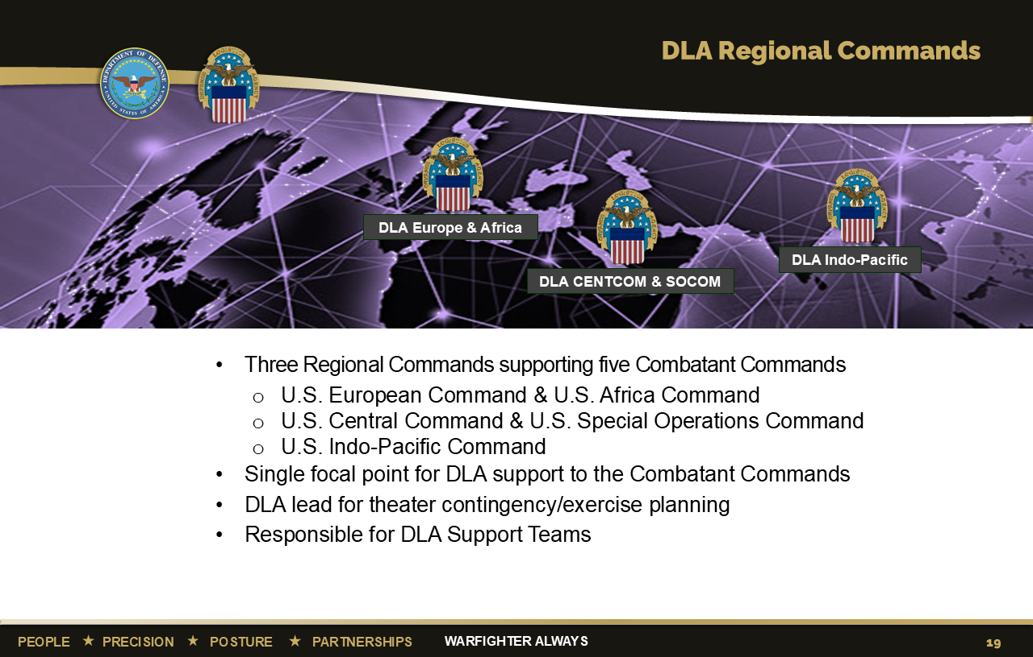
Notes:
We are structured to support the warfighter across the world.
To provide a single face to customers in U.S. European, Africa, Central, Special Operations and Indo-Pacific Commands, and improve the alignment and authorities of the DLA regional commanders, we’ve postured our major subordinate commands under a single regional commander. This arrangement streamlines our customers’ interaction and provides unified and responsive support in the theater of operations.
DLA Europe & Africa, DLA CENTCOM & SOCOM and DLA Indo-Pacific each provide a single DLA interface/focal point to the geographic combatant commanders, integrating DLA support throughout the areas of responsibility.
We support the other combatant commands through liaisons that are collocated and interface with:
– U.S. Northern Command (USNORTHCOM) in Colorado Springs, Colorado (Peterson Air Force Base)
– U.S. Southern Command (USSOUTHCOM) in Miami, Florida
– U.S. Strategic Command (USSTRATCOM) in Omaha, Nebraska (Offutt Air Force Base)
– U.S. Transportation Command (USTRANSCOM) (Scott Air Force Base)
As of June 2022

Slide 20
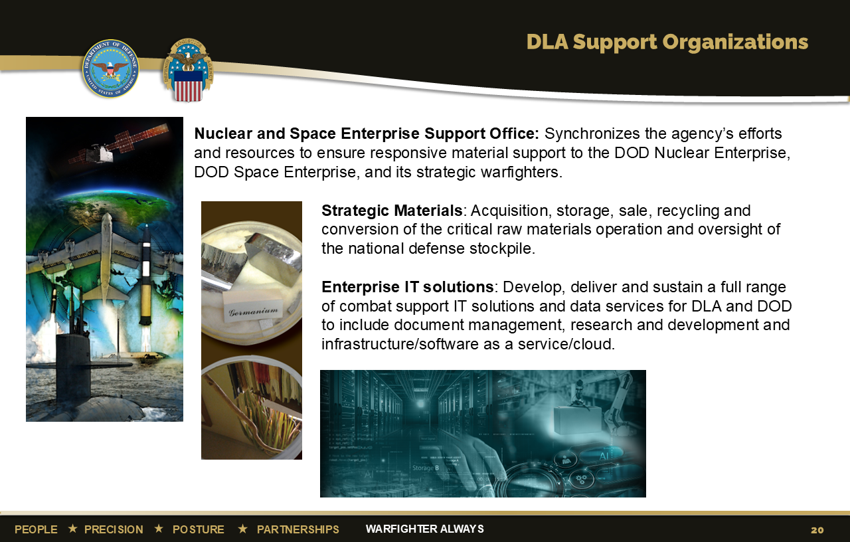
Notes:
These are other services that DLA performs, all necessary in supporting national defense.
The Nuclear & Space Enterprise Support Office synchronizes processes and procedures necessary to optimize Nuclear Enterprise (NE) and Space Enterprise (SE) support, sustainment, and modernization efforts. Provides NE/SE customer materiel requirements for Combatant Commands and Military Services. Ensures DLA-managed materiel is not a limiting factor for NE/SE warfighters by intensively managing inventory investment to satisfy customer requirements. NESO functions as DLA's lead organization to the Department of Defense (DOD) and Department of Energy (DOE) Nuclear Enterprise (NE) and the Space Enterprise (SE) by synchronizing DLA policy, planning, resourcing, and procedures supporting United States Navy, United States Air Force, United States Space Force, Joint Chiefs of Staff, and OSD organizations with strategic national, strategic theater, and operational responsibilities supporting the DOD NE and SE. Responsible for analyzing and integrating responsive sustainment and support efforts with external customers, identifying and resolving gaps and shortfalls in NE and SE support, overseeing handling of Nuclear Weapons Related Material, and monitoring the health, capability, and performance of DLA systems supporting the NE and SE. Collaborates with NESO LNOs located with USSTRATCOM, USSPACECOM, USSF, AFGSC, AFNWC and NESO teams across DLA Major Subordinate Commands. Coordinates readiness requirements with DLA's Agency Synchronization Operations Center. Guides strategic engagement and collaboration with internal DLA stakeholders at headquarters and field level. Supports strategic stakeholder engagements with OSD entities, the Joint Staff, Geographic Combatant Commanders, Functional Combatant Commanders, Service Component Commands, Title 10 Service force providers, and other organizations within the DOD NE and SE, to include providing DLA planning support for plans developed in support of the National Military Strategy and the National Security Strategy. Works with officials of the Military Services' Headquarters and their operations and sustainment commands to collaborate on and resolve NE and SE shortfalls.
Strategic Materials falls under DLA Acquisition (J7) and has the primary mission to plan, facilitate, and acquire services and supplies necessary to support the storage and sale of its strategic and critical materials inventory located in depots throughout the U.S. Examples are: chromium, platinum, germanium, beryllium, titanium and mercury.
The J6 provides a variety of services for DLA and DOD to include:
Enterprise IT solutions: Develops and delivers a variety of IT solutions and data services.
Document Management: Provides document automation products and services to the DOD and designated federal activities, including imaging and conversion of documents to electronic media, digital warehousing, and distribution of digital and hardcopy information. DLA Document Services is the single manager for all DOD printing and duplicating.
Research & Development: Provides world-class R&D efforts, using internal/external partnerships, rapid prototyping and technology adoption, and flexible processes, focusing on supply chain logistics risks to address industrial base manufacturing issues.
Infrastructure services: Delivers a full range of IT infrastructure solutions in support of DLA operations; providing reliable IT infrastructure for all applications, systems and users ensuring adequate availability for mission completion, and serve as the Agency's application hosting expert supporting both the movement of applications to the cloud and data center consolidation initiatives.
As of June 2022

Slide 21
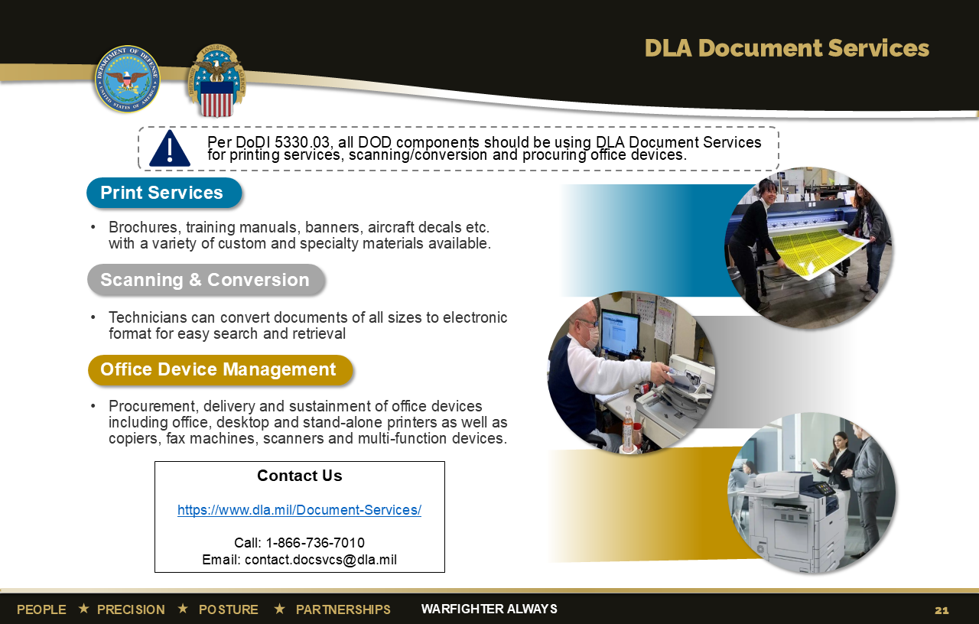
Notes:
DLA is now the Defense Department’s primary provider of printing services, office print devices and electronic conversion services according to a DOD instruction signed by the Under Secretary of Defense for Acquisition and Sustainment.
Department of Defense Instruction 5330.03 establishes policy and assigns responsibilities to DLA as the single manager of document services in the DOD.
The instruction directs DOD components to solely use DLA Document Services for production printing, procuring office multifunctional devices and scanning and conversion – unless their requirements qualify for an exception.
DOD components include: OSD, the Military Departments, the Office of the Chairman of the Joint Chiefs of Staff and the Joint Staff, the Combatant Commands, the DOD Office of the Inspector General, Defense Agencies, DOD Field Activities and all other organizational entities within the DOD. Excluded: DOD intelligence agencies, National Guard and Reserve organizations, tactical activities and the U.S. Army Print and Media Distribution Center.
Use of DLA’s services will eliminate duplicate efforts and allow DOD components to focus on their core missions.
Document services consolidation under the updated policy will reduce costs for DOD and return scarce funding for other DOD priorities, potentially tens of millions of dollars each year.
DLA Document Services provides:
- Procurement (lease or purchase), delivery and sustainment of office printing devices, desktop and stand-alone printers, copiers, fax machines, scanners and multi-function devices.
- Production and delivery of unclassified, official use only, personally identifiable information, controlled unclassified information and classified (up to the Secret level) printed products in hard copy, such as banners, decals, technical manuals and other hard copy publications that cannot be economically produced on office printing devices.
- Production and delivery of documents in electronic form through document scanning or conversion of files to standard electronic formats that can be opened, viewed or edited using a software program on a computer.
DLA Document Services evaluates and delivers effective document service capabilities based on best value, as determined by the quality, price and delivery time, in coordination with customer requirements.
DLA Document Services has been providing professional document services for more than 70 years with the highest quality and customer service.
As of June 2022

Slide 22
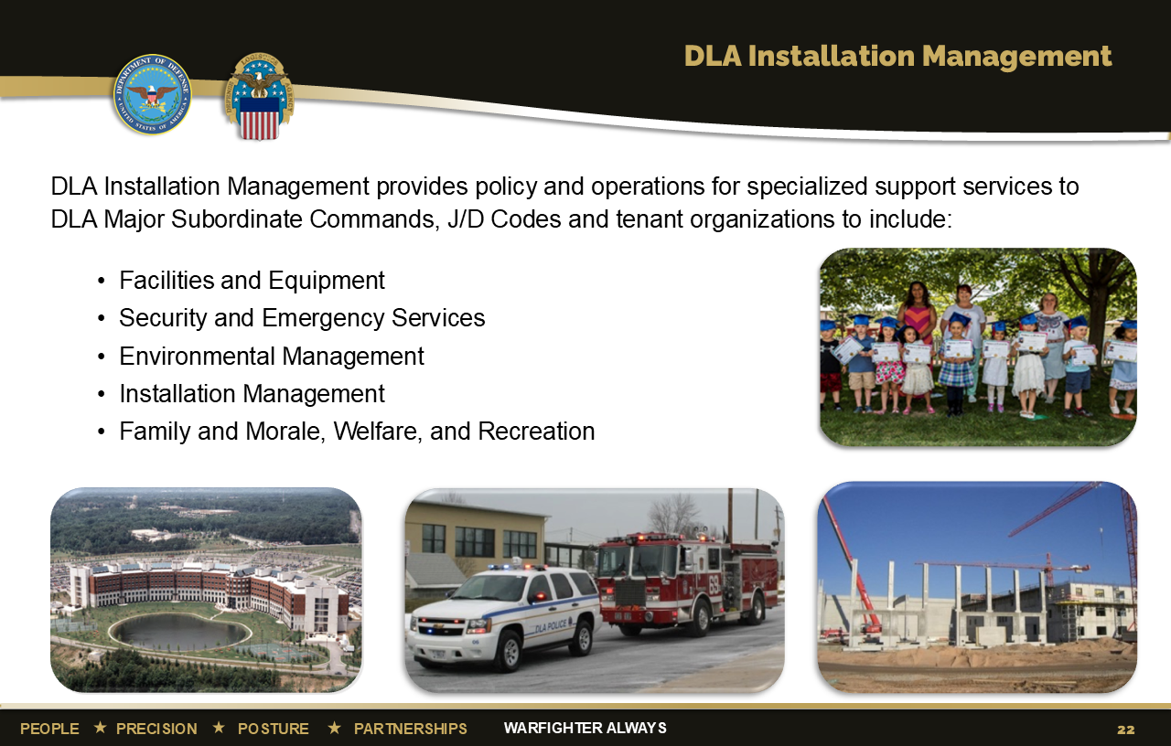
Notes:
DLA Installation Management—Policy provides policy and oversight for specialized support services to DLA.
Facilities and Equipment: Responsible for military construction, real property maintenance activities, military family housing, energy resource management, facilities master planning, real estate, administrative space management, operating equipment and motor vehicles, property accountability, retail supply policy, and engineering support program.
Security and Emergency Services: Responsible for all DLA police and fire departments.
Environmental Management: Responsible for providing Agency-wide policy, program, and operational support in the areas of environmental compliance, restoration and sustainability.
Safety and Occupational Health: Provides policy, guidance, and oversight for the Agency Occupational Safety and Health Program.
Process Management: Provides guidance and directions to employees to document enterprise processes, test controls, correct deficiencies and ensure the numbers are traceable and proof exists to achieve auditability.
DLA Installation Management—Operations provides DLA with the installation capabilities and services to support the DLA mission.
Quick Facts: There are 2,071 General Schedule/Wage Grade/Non-appropriated Fund civilian employees which includes 480 police officers and firefighters. There are also 250 contract employees supporting the organization.
Manages more than 17,000 real property assets at more than 600 locations. Examples include land, buildings, structures, utilities systems and includes equipment attached to and made part of buildings and structures (such as heating systems).
Manages more than 18,000 general equipment assets. Examples include forklifts, servers, copy machines, trucks, and video conferencing equipment.
Manages more than 2,500 capital equipment assets, which are the same as general equipment assets with a value of more than $250,000
Manages five child development centers located at Fort Belvoir, Virginia; Richmond, Virginia; Columbus, Ohio; Susquehanna, Pennsylvania and San Joaquin, California.
Supports DLA Distribution Centers and DLA Disposition Services sites located worldwide.
Installation Operations site directors are co-located with DLA MSCs and DLA regional commanders.
As of June 2022

Slide 23
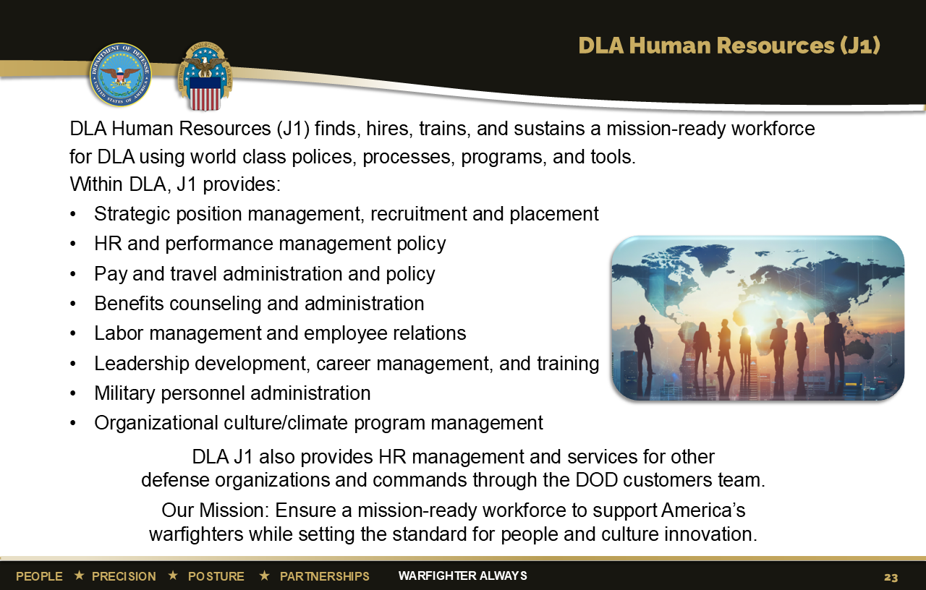
Notes:
DLA recognizes a high-performing, valued, resilient and accountable workforce is vital to current and long-term success in effectively supporting the warfighter.
J1, DLA Human Resources, advises and assists the DLA Executive Board in building and sustaining an exceptional civilian and military workforce within DLA. In support of the DLA mission, DLA Human Resources finds, trains, and sustains a mission-ready workforce for DLA and our HR customers, using world class policies, processes, programs, and tools.
In addition to providing full HR support to DLA, J1 provides HR services to other DOD agencies on a reimbursable basis.
J1’s mission entails developing a strategic approach and requisite policies/programs in the areas of: talent management, leadership development, change management, personnel staffing, position classification, employee relations, labor relations, training, executive development, career management, pay administration, performance management, incentive awards, injury compensation, certain worker/family support programs, employee assistance program, sexual assault prevention and response, management information, military personnel, military manpower management, and the DLA Senior Executive Service Program.
J1 oversees the provision of services by the DLA Human Resources Services, DLA customers; Enterprise Operations; DLA Payroll and Travel; Human Resources Information Systems; Military Personnel; DLA Training; Workforce Development Policy and Program Support; and DOD customers.
As of June 2022

Slide 24
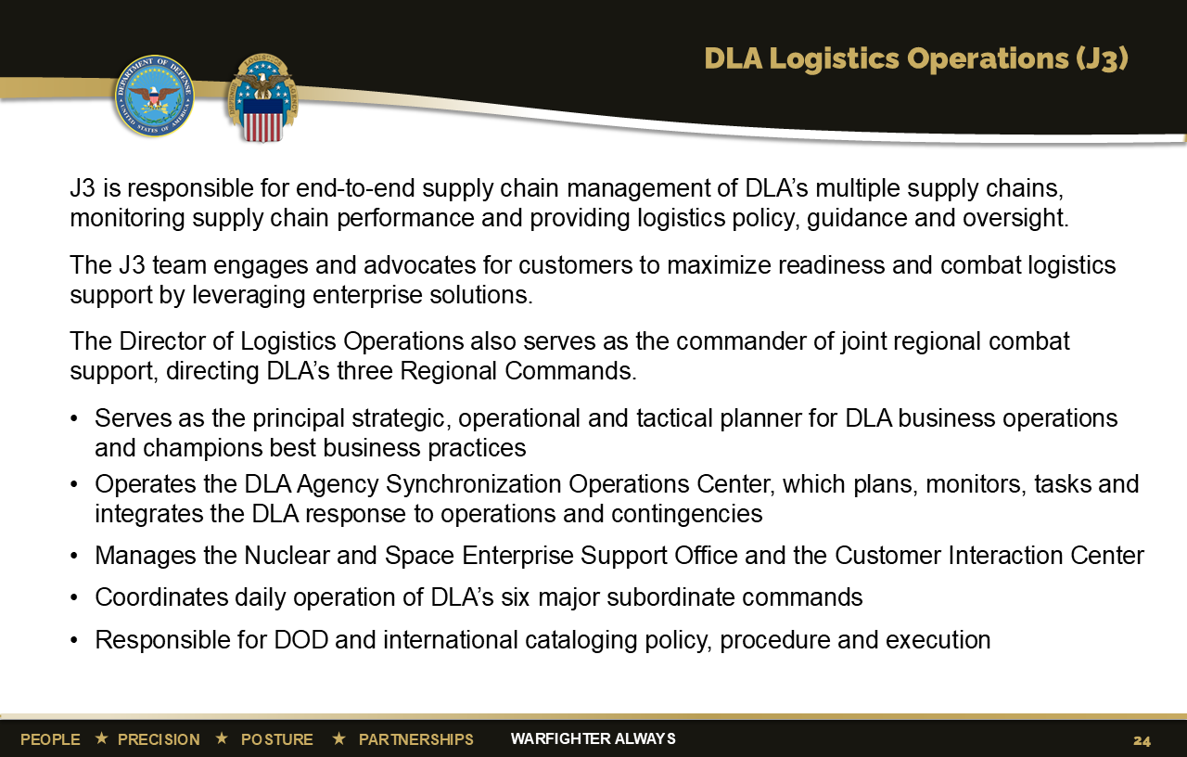
Notes:
J3, DLA Logistics Operations, is responsible for end-to-end supply chain management of DLA’s multiple supply chains. J3 provides logistics and materiel process management policy, guidance and oversight while conducting continuous assessments of supply chain performance.
J3 is the critical link to military service customers and the combatant commands for the entire Agency. This directorate links DLA’s vast sustainment capabilities to warfighter demand in order to deliver end-to-end supply chain effectiveness.
J3 functions as the strategic and operational focal point to:
– Build mutually beneficial partnerships with every DOD component
– Establish and execute measurable performance agreements
– Collaboratively manage DLA account plans for each military service
– Develop engagement strategies for each service
– Cultivate new opportunities for DLA support
Additionally, the J3 integrates DLA support for the DOD enterprise, synchronizing responsibilities for all the related policy and procedures, monitoring the health, capability, and weapons systems performance for this mission set, and working with the Military Service Headquarters on weapons system support improvement initiatives.
The J3 also manages expeditionary missions including the Global Response Force Rapid Deployment Teams, in addition to the traditional DLA Support Teams.
J3 Background:
– Acts as a customer advocate for the Agency, maintaining close relationships with our stakeholders through regional commanders, deployed support teams, combatant command and major mission area liaison officers and customer service representatives
– Serves as DLA’s primary focal point for new supply chain concepts, proposals, initiatives and assessments
– Executes strategic planning and analysis and recommends operations, business processes, information systems and policy improvements to synchronize and improve end-to-end performance of supply chains
– Operates the DLA Agency Synchronization Operations Center, which monitors, tasks and integrates the DLA response to operational and contingency requirements
– Plans, conducts and participates in joint exercises
– Supports worldwide humanitarian relief efforts
– Synchronizes responsibilities for all Nuclear Enterprise-related policy and procedures
– Assists the combatant commands with executing their Operational Contract Support mission
– Houses the Center of Planning Excellence, the PBL Center of Excellence, and the Customer Interaction Center
– Advocates for the MSCs and oversees their activities
– Oversees the DLA foreign visitor program
As of June 2022

Slide 25
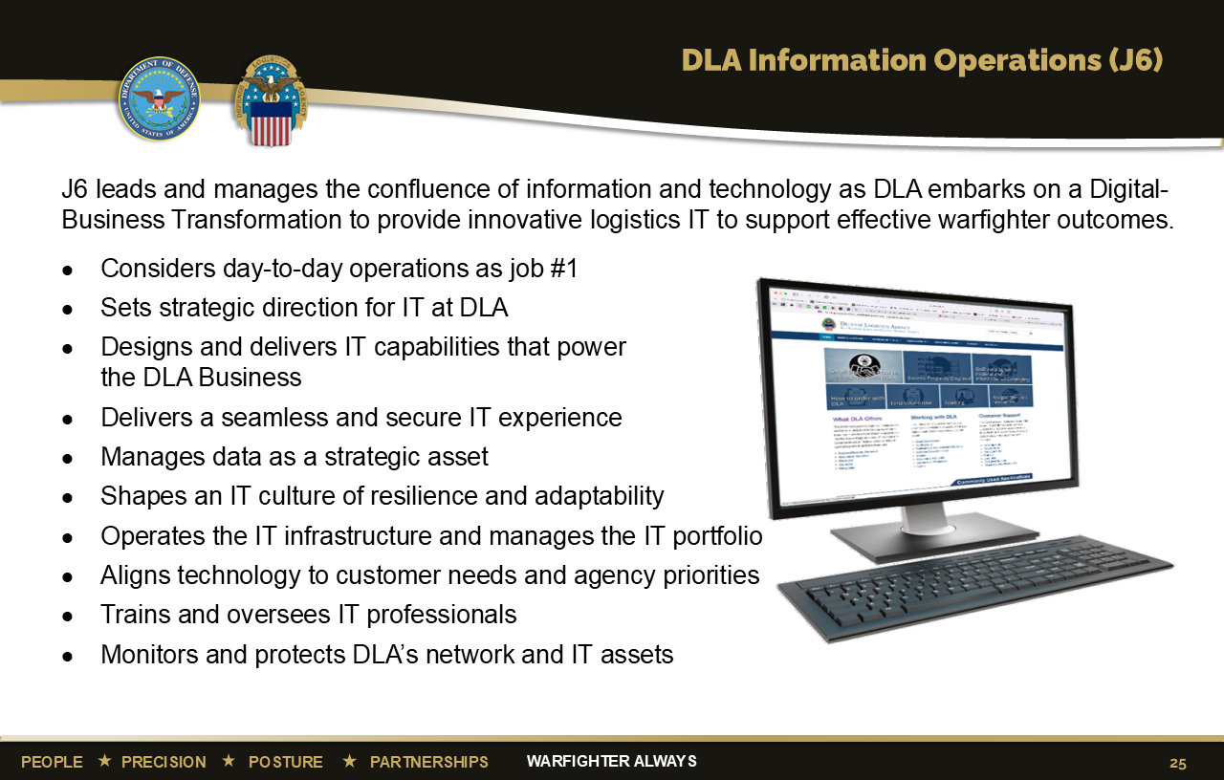
Notes:
J6, DLA Information Operations, leads and manages the confluence of information and technology for DLA, providing comprehensive, best practice Information Technology support to the DOD/DLA logistics business community. J6 also provides high quality information systems, customer support, efficient and effective computing, data management, electronic business, telecommunication services, and secure voice systems.
J6 is responsible for all things IT within DLA and believes their #1 job is to keep the “day-to-day IT operations” up and running 24/7. Their goal is to provide business value and capabilities to help DLA serve the warfighter, while promoting a culture of IT resiliency and adaptability.
J6 Field Activity offices provide on-site support to all DLA MSCs and units for networks, communications, applications, desktops, phones, video teleconferences, and communications security.
J6 provides direct support at each DLA location and provides IT support for overseas deployments and personnel in other “forward” locations.
As of June 2022

Slide 26
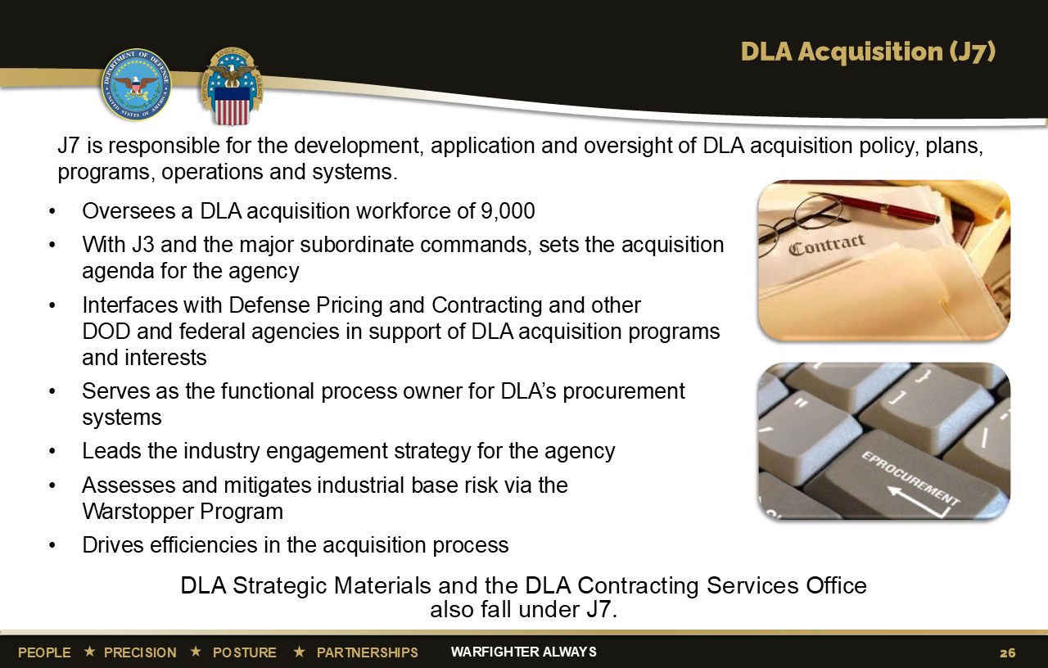
Notes:
J7 is responsible for the development, application and oversight of DLA acquisition policy, plans, programs, operations and systems.
Oversees a DLA acquisition workforce of 9,000
With J3 and the major subordinate commands, sets the acquisition agenda for the agency
Interfaces with Defense Pricing and Contracting and other DOD and federal agencies in support of DLA acquisition programs and interests
Serves as the functional process owner for DLA’s procurement systems
Leads the industry engagement strategy for the agency
Assesses and mitigates industrial base risk via the Warstopper Program
Drives efficiencies in the acquisition process
DLA Strategic Materials and the DLA Contracting Services Office also fall under J7.
As of June 2022

Slide 27
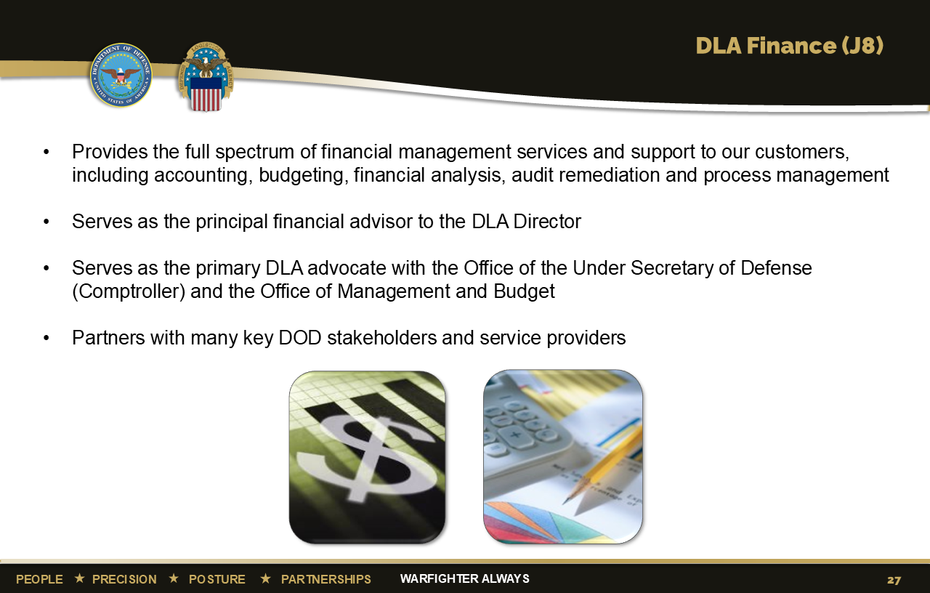
Notes:
J8, DLA Finance, provides the full spectrum of financial management services and support to our customers, including accounting, budgeting, financial analysis, audit remediation and process management.
J8 is the principal financial advisor to the DLA Director and the primary DLA advocate with the Office of the Under Secretary of Defense (Comptroller) and the Office of Management and Budget.
DLA Finance also partners with many key Department of Defense stakeholders and service providers, such as Congressional Authorization and Appropriation staff members, Office of the Undersecretary of Defense (Acquisition & Sustainment) and the Defense Finance and Accounting Service.
Approximately 750 J8 financial professionals at seven locations across the United States and provided more than $48.2 billion
in goods and services FY2022.
J8 also leads stewardship and audit remediation activities for the agency.
As of February 2023

Slide 28
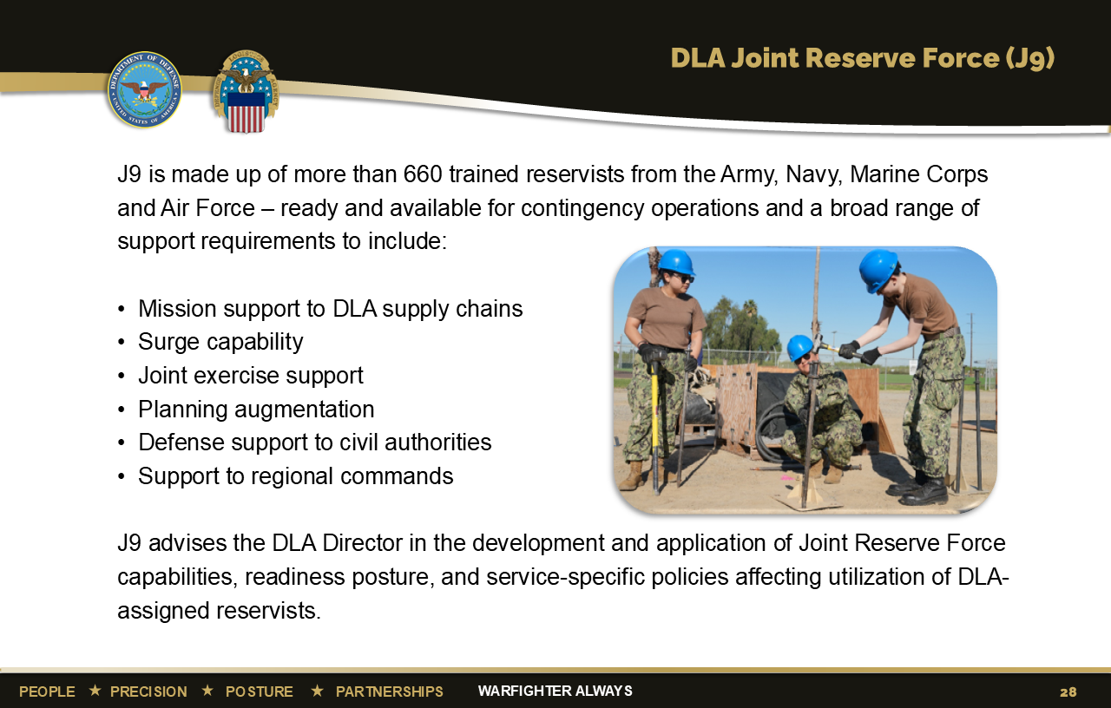
Notes:
J9, DLA Joint Reserve Force, is comprised of more than 660 Reservists. They provide trained, ready and available Reservists from the Army, Navy, Marine Corps and Air Force, to enable DLA to accomplish its worldwide combat support agency logistics mission.
J9’s objectives are to:
Develop an organization of highly skilled, multifunctional, joint logistics professionals who understand all aspects of DLA operations and customer service
Provide DLA with trained and ready Reservists who can mobilize and deploy to support DLA's worldwide mission
Integrate and build joint reserve capability to support a wide range of DLA operations and activities
Maintain compliance with Service-specific regulations and requirements to deliver maximum value to DLA’s military customers
As of June 2022

Slide 29
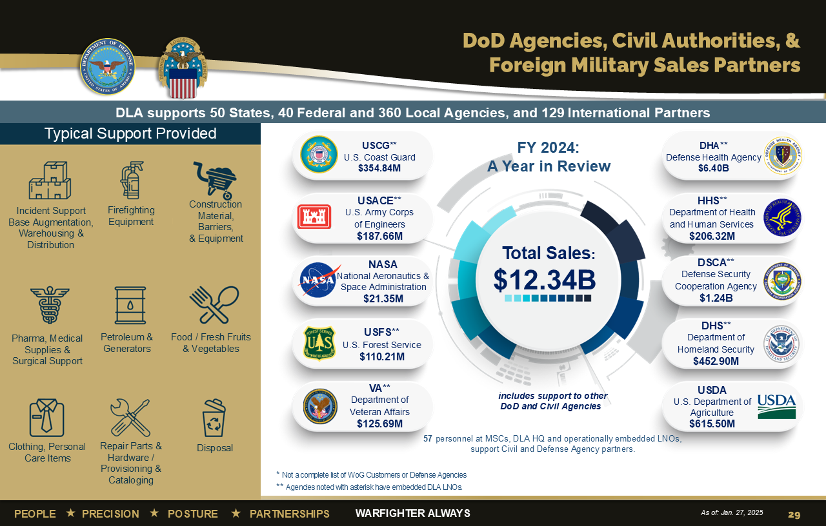
Notes:
DLA’s Whole of Government is a key Agency Line of Effort that aligns to SECDEF priorities on response to national needs, whole of nation, and economic interests
DLA provides supply chain management needs for the nation, while still meeting the needs of the military – Warfighter Always
Leverages economies of scale
Provides competitive acquisition and operating costs for all customers
DLA’s Whole of Government portfolio includes 40 federal, 50 states, 360 local and 129 international partners
In Fiscal Year 2024, Whole of Government sales were $12.34 billion.
57 DLA personnel support civil and defense agency partners
Typical support to WOG includes:
Fuel and generators
Firefighting equipment
Food
Repair parts
Typical support to Defense partners includes:
Pharmaceuticals
Medical supplies
Foreign Military Sales
As of January 2025

